Slide 1
Assessing Risk: An Introduction
Module 3

Slide 2

Objectives
Qualitative and quantitative risk analysis methods
Analyse risk in terms of impact and likelihood of occurrence
Use the standard risk model to score likelihood of risks and impacts
Develop impact attributes to connect risk impacts
Notes:
This module is targeted at risk assesment in the risk management process

Slide 3

The Purpose of Risk Analysis
Understand what is most uncertain about a risk
Determine attention given to different risks
Determine appropriate responses needed
Notes:
Risk – Unknown condition or event with known or reasonably estimated probability that may or may not impact the organization either positively or negatively
Issue – Risks materialized
Constraint – Identified restriction
Uncertainty – Unknown condition or event with unknown probability

Slide 4

Qualitative and Quantitative methods
Qualitative methods: to assess and prioritize risks - probability and impact matrix (risk heat map)
Quantitative methods: to determine the magnitude of impact.

Slide 5

Risk analysis
Understand risk probability (likelihood) and the risk impact
Asure quality risk information
Categorize the risks
Identify the urgency of the risk (close to issue)
Notes:
Risk probability is the likelihood that the risk will become an issue
Issue = realised risk

Slide 6
Three ways to assess risk probability
Apply a probability of 1 to 9 to represent likelihood.
Apply risk qualitative probabilities with a probability range of categories.
Use a quantitative method which applies a specific value between 0 to 1 to each risk
Notes:
Apply a probability of 1 to 9 to represent likelihood. Use the risk calculation sheet provided in class
Methods to estimate probability include mathematical model, empirical data, educated guess, or prior or experience
Apply risk qualitative probabilities which establish and provide a probability range to choose from the range below;
Low - 0 to 15 percent
Moderate - 15 to 50 percent
High - 51 percent or higher
You choose the appropriate range of categories.
Use a quantitative method which applies a specific value between 0 to 1 to each risk

Slide 7
Three Ways to Assess Risk Impact
Qualitative- range or category of impact
Quantitative- estimate of impact
Non-measurable risk impact
Notes:
Qualitative: choose either value from range or category (use the risk calculation sheet provided in class)
Range - score 1 to 9
Category - high, medium, and low
Quantitative: apply precise estimate of impact (sometimes inaccurate)
Non-measurable risk impact: personal consequences, career penalties, loss of team productivity, team discord, organizational impact

Slide 8
Steps of Qualitative Risk Analysis
Select the appropriate qualitative risk analysis tool
Adapt tools to scale and scope of the organization
Apply tools to perform the qualitative risk analysis
Select risks for quantitative risk analysis
Update risk log and risk treatment and response plan

Slide 9
Primary Qualitative Risk Analysis Tools
Risk Rating Schemes
Probability/Impact Assessment & Matrix
Urgency Assessment
Risk Breakdown Structure
Risk Factors
Notes:
> used to document and assess risks

Slide 10
Secondary Qualitative Risk Analysis Tools
Expert Judgement
Planning Meetings
Analogy Comparison
Delphi Technique
Root Cause Analysis
Data Quality Assessment
Risk Modeling
Notes:
help identify risks that are identified in the primary examples.
When selecting a qualitative risk analysis tool(s), consider:
Size, scope and importance to the organization
Available time and who will be conducting the assessments
Organizational resources and knowledge of risk management
Having an outside consultant or driving the approach from the risk management department

Slide 11
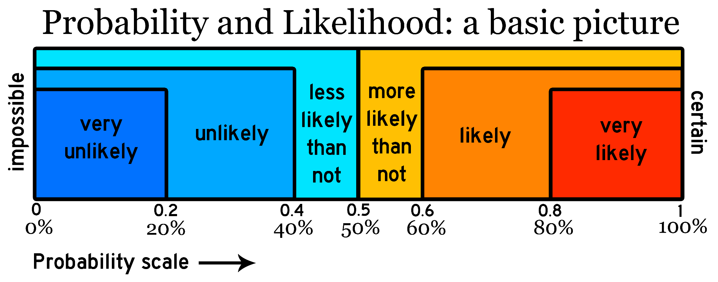
Risk Probability and Impact Assessment
Notes:
It is important to assess the risk in terms of likelihood and impact so the organization is not spending resources on risks that will never impact the company.

Slide 12
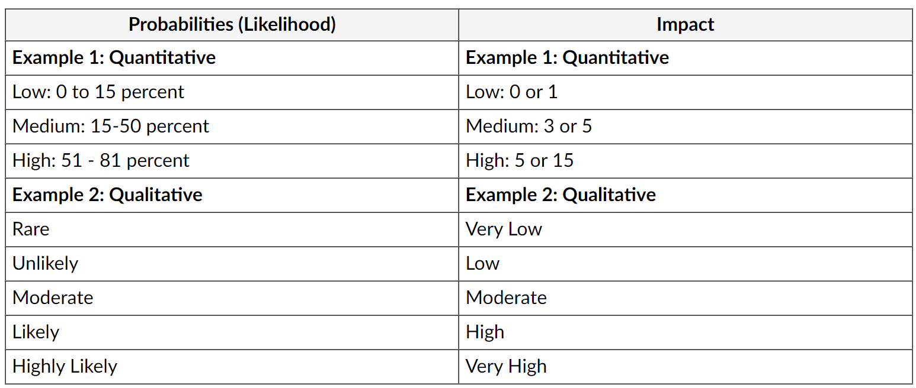
Examples for scaling probabilities and impact

Slide 13
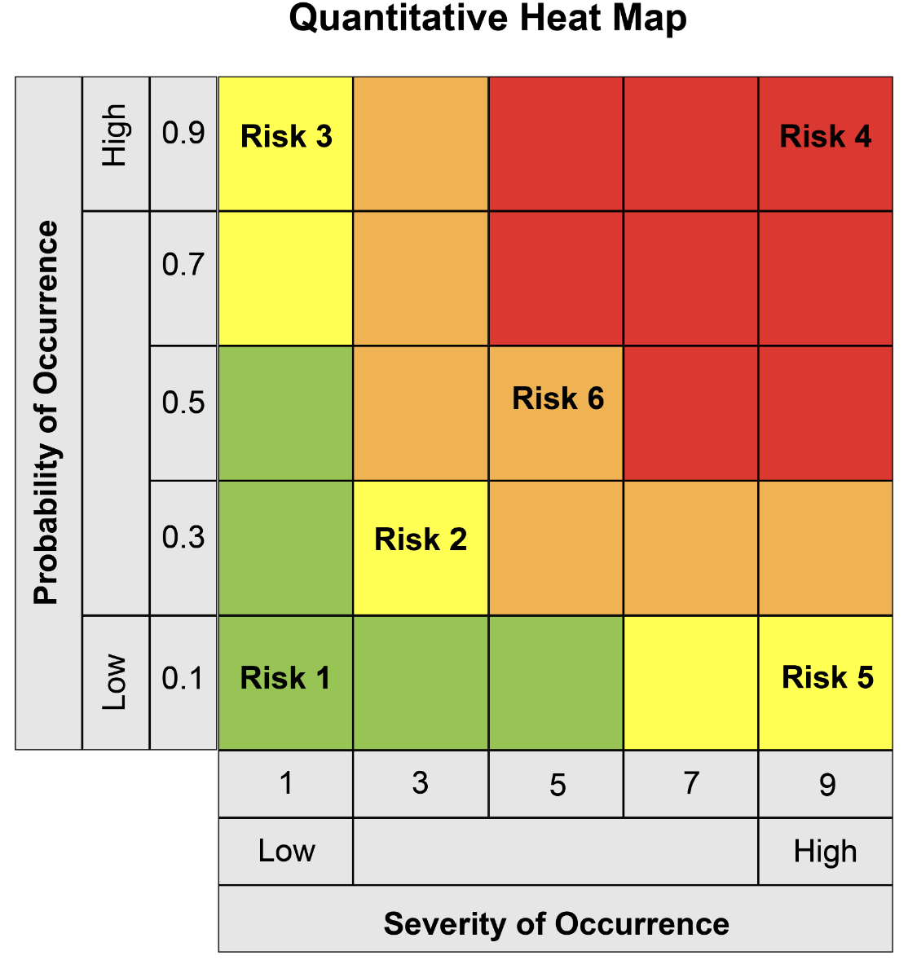
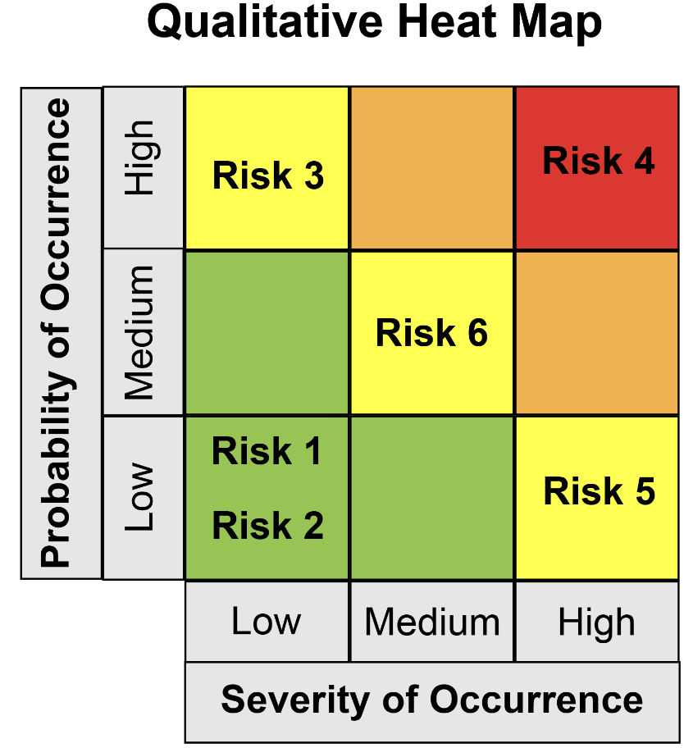
Creating a Risk HeatMap
Notes:
Probably and Impact Matrix = Risk Heat Map
When you have assigned a probability and impact measurement for each risk, it is useful to create a risk heat map that will help you visualize the risks to track more closely.

Slide 14
Identifying Urgency of Risk
Time available to respond or mitigate the risk
The likelihood of the risk occurring
Impact of the risk to the organization
If it becomes an issue
Whether the organization can deal with it in a timely manner and pay for it.
Notes:
> The risk urgency assessment determines which risks are more critical to the organization and closest to becoming an issue that must be dealt with.
> Risk assessments will be ongoing and risk scoring will evolve over time as the organization grows and new strategies are implemented. Risk managers will rely on data analysis to help shape and assess risk all the time.

